Slide 1
VCE Product Design and Technology: School-assessed Task− Authentication
Dr Leanne Compton, Curriculum Manager−Design and Technologies
Simon Van Dillen, State Reviewer

Slide 2
VCAA authentication documents
Details of authentication requirements and administrative arrangements for School-assessed Tasks (SATs) are updated annually and published in the VCE and VCAL Administrative Handbook.
The Authentication record form in the VCE Product Design and Technology: Administrative information for School-based Assessment is to be used to record information for each student and must be made available on request by the VCAA.

Slide 3
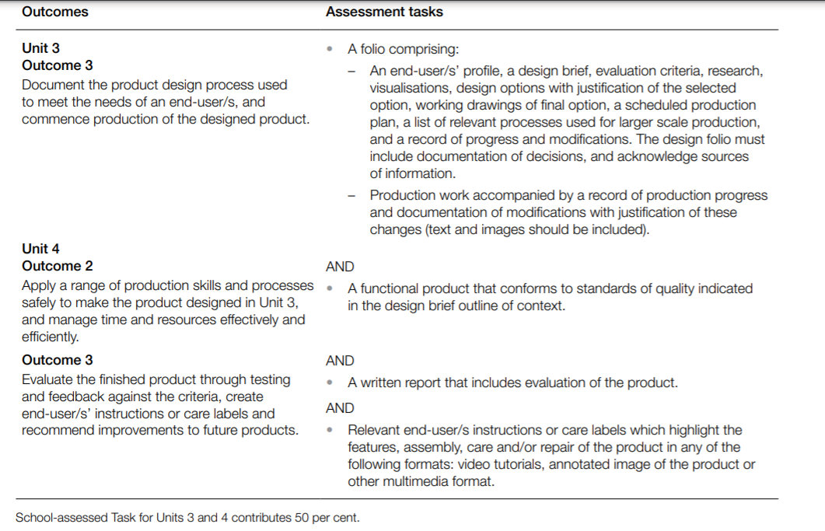
Nature of the School-assessed Task

Slide 4
Why authenticate the SAT?
Specified in the Assessment: School-based Assessment section of the VCE and VCAL Administrative Handbook. This is important to ensure that ‘undue assistance [is] not …provided to students while undertaking assessment tasks’.
Teachers must be aware of the following requirements for the authentication of VCE Product Design and Technology SATs

Slide 5
Authentication requirement
The product created for the Product Design and Technology SAT Unit 4 Outcomes 2 and 3 is based on the design folio completed in Unit 3 Outcome 3, which documents the product design process used while working as a designer to meet the needs of an end user/s.

Slide 6
Authentication requirement
Students must work on their own design and production work. It is not a group project. Teachers must sight and monitor the development and documentation of the student’s work on a regular basis.
The VCE Product Design and Technology School-assessed Task Authentication record form must be completed at appropriate stages to monitor the student’s work-in-progress for authentication purposes. This form must be available if requested by the VCAA.

Slide 7
Authentication requirement
Undue assistance may occur during the design folio and/or production process and teachers need to be vigilant. Students are encouraged to research in detail all aspects of their proposed products, and must accurately document all sources of research
The work undertaken related to their design folio and production must be their own, with appropriate referencing of research undertaken.
During the planning stage, teachers must make it clear to students that the written documentation and visual representations required as part of the design folio form the basis for authentication of their production work.

Slide 8
Authentication requirement
All use of external support and/or equipment must be planned and documented in the student’s design folio. If work has been outsourced, the student must document this accurately.
Teachers must certify that such support does not constitute undue assistance.
All resource materials and assistance used must be acknowledged in the Authentication record form.

Slide 9
Authentication requirement
During the production stage, teachers must sight and monitor the development and documentation of students’ work on a regular basis.
Teachers are reminded that it is not appropriate to provide ‘detailed advice on, corrections to, or actual reworking of students’ drafts or productions or folios’.

Slide 10
Authentication requirement
Application of skills, particularly those related to the safe use of tools, equipment and machines and application of production processes should be documented on the Product Design and Technology Authentication record form.
The appropriate documentation must be included if students have used plant items requiring a Student safe use test or Restricted plant items. www.education.vic.gov.au/hrweb/safetyhw/Pages/technology.aspx

Slide 11
Authentication requirement
Photographs taken during the production stage must be true and accurate representations of a student’s work – this should be recorded in the final submission comments section of the Authentication record form.
Photographs must be dated. This assists in ensuring the product can be authenticated as a realisation of the design folio developed by the student, and that the student is not receiving undue assistance. In turn, this ensures that all students are assessed equitably.

Slide 12
Authentication record form
The purpose of the Product Design and Technology Authentication record is for the teacher to document student progress throughout the completion of the SAT.
In particular, teachers should make ongoing notes of observations of each student during the production of the SAT on this form.

Slide 13
Authentication record form
The form provides teachers with the opportunity to present written information that may be requested in the School-based Assessment Audit.
As the production work for the SAT occurs over a period of time, it can also assist teachers in their record keeping. Teachers may find it useful to refer to the comments on the Authentication record form when assessing the four criteria related to the production work.
The criteria related to the production work for Product Design and Technology are criteria 5, 6, 7 and 8.

Slide 14
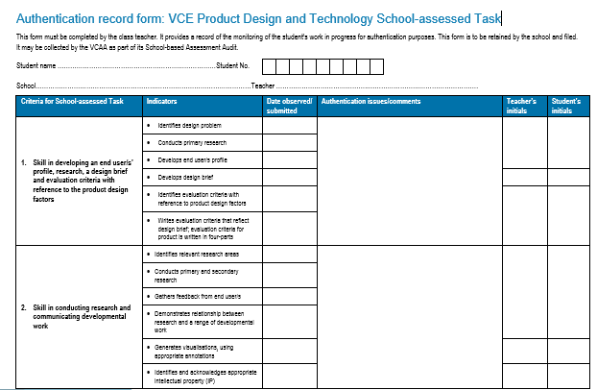

Slide 15
SAT Q&A webinar
A Q&A webinar related to the SAT will be held in Term 1. Refer to the VCAA February Bulletin for details of the date and how to register.
Any questions, information or clarification you would like to be covered during this webinar, please email to Leanne Compton leanne.compton@education.vic.gov.au

